Slide 1
Front End Engineering-I Project
Team Details:
G5, Team-11
GOURI SHARMA(2310990423)
DHRUV SHARMA(2310990410)
ARYAN SINGLA(2310990389)
ARYAN GARG(2310990387)
Faculty Coordinator: Mr. Amitabh Shrivastava
:
Chitkara University Institute of Engineering and Technology,
Chitkara University, Punjab

Slide 2
Table of Contents
Introduction
Problem Statement
Technical Details
Key Features
Project Highlights
Conclusion
References/Links used

Slide 3
Introduction
Title of the project:
RESTAURANT WEBPAGE
Tagline of the project:
Bite&Dine: Savor Every Click, Relish Every Bite
Team Details:
Gouri Sharma (2310990423)
Dhruv Sharma (2310990410)
Aryan Singla (2310990389)
Aryan Garg (2310990387)

Slide 4
Introduction
Welcome to Bite&Dine—your ultimate destination for a seamless and delightful online dining experience. Whether you're a food enthusiast or just looking for a quick bite, Bite&Dine is designed to cater to all your culinary needs with just a few clicks..
Our intuitive interface makes it easy for you to discover new variety of delicacies, browse menus, and place orders effortlessly. With a streamlined ordering process, enjoying your favorite meals has never been easier..

Slide 5
Problem Statement
In today's fast-paced world, dining preferences have evolved significantly. Consumers seek the convenience of ordering food online without compromising on quality, variety, or the dining experience . However, online food platforms often fail to provide a seamless, personalized, and customer-centric service. Users frequently encounter issues such as
limited options
cumbersome interfaces
generic recommendations
ack of transparency in delivery
minimal customer support.
By focusing on customer satisfaction, providing user-friendly interface, and delivering exclusive deals, Bite&Dine ensures that users can enjoy their favorite meals effortlessly and confidently. Bite&Dine is the solution for those who demand more from their online dining experience—a platform where convenience meets culinary excellence.

Slide 6
Technical details
The project “RESTAURANT WEBPAGE” is made by using HTML, CSS, JAVAScript.
HTML: It is used to create basic structure i.e. webpage development of the project which uses various types of tags such as ‘anchor tags(<a>,</a>)’, ‘paragraph tags(<p>,</p>) etc.
CSS: It is used to decorate and add various styles
for development of webpage. In our project we

Slide 7

Technical details
had also used CSS tools such as padding, borders, colors etc. to make our project attractive.
JAVAScript: It is used to create a interface and dynamic webpage to interact with the users and to execute complex operations. We had used various terms like ‘script tags’, ‘calling element by it’s id’, ‘concept of variables’ etc.

Slide 8
Technical Details
Tags Description
1.<!DOCTYPE> Define the document 2.<div> Defines a section in a document
3.<footer> Defines a footer for a section
4.<header> Defines a header for a section
5.<script> Defines a client-side script
6.<ul> Defines a unordered list
7.<li> Defines a list item
8.<h1>to<h6> Defines a HTML headings

Slide 9
Key Features
User-Friendly Interface: The platform is designed for ease of use, allowing users to navigate menus, place orders, and discover new dining options effortlessly. The clean and intuitive design makes the entire process seamless and enjoyable.
Personalized Recommendations: Bite&Dine’s smart recommendation engine suggests dishes and restaurants based on users' past orders and ratings, making each dining experience uniquely tailored to individual preferences.
Exclusive Deals and Offers: Bite&Dine offers exclusive discounts, loyalty rewards, and special deals that are only available to its users, providing great value with every order.

Slide 10
Key Features
Product Reviews and Ratings: Customers can leave reviews and ratings to help others make informed purchasing decisions.
24/7 Customer Support: A dedicated customer support team is available around the clock to assist users with any queries, ensuring a smooth and hassle-free experience.

Slide 11
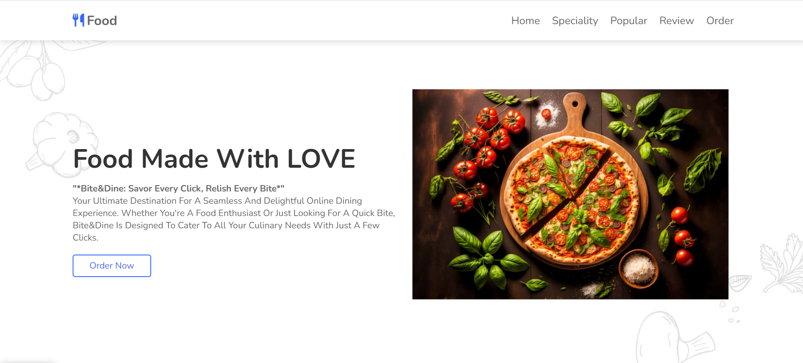
Project Highlights
Homepage

Slide 12
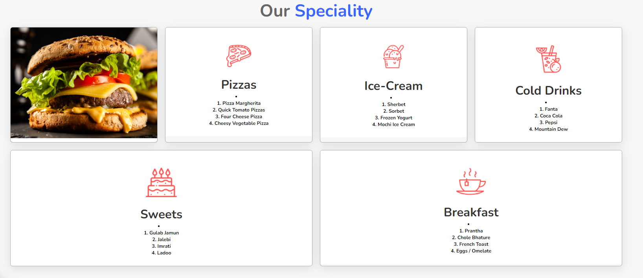
Project Highlights
Products Page

Slide 13
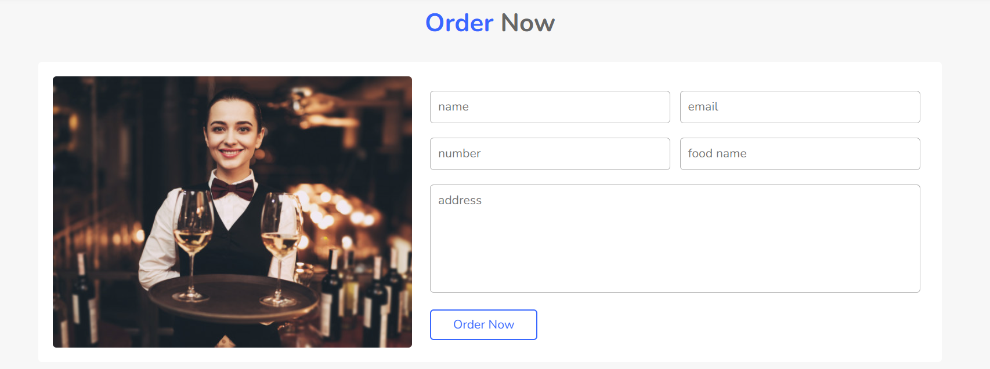
Projects Highlights
Login Page

Slide 14

Project Highlights
Contact Us Page

Slide 15
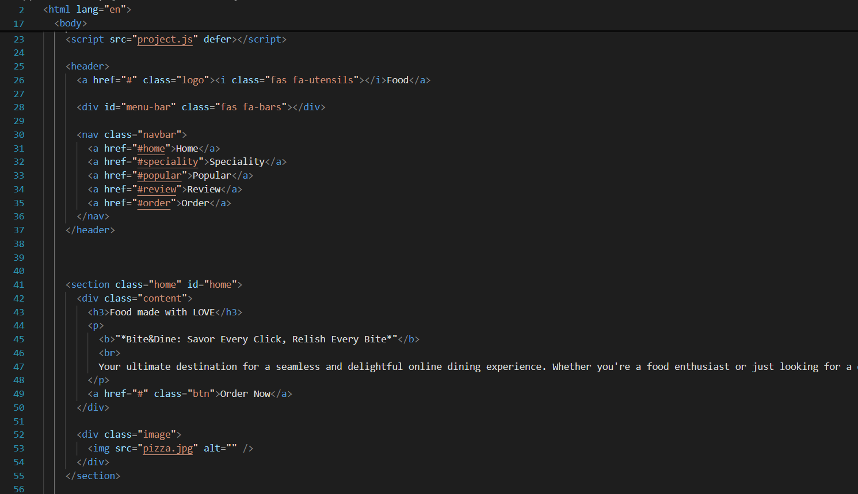
Project Highlights
Homepage HTML

Slide 16
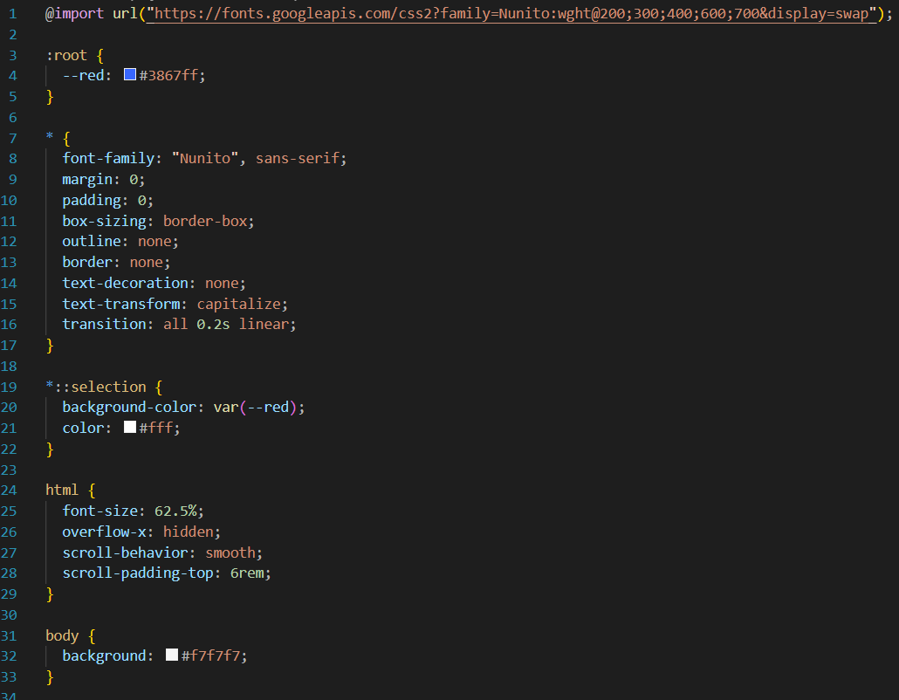
Project Highlights
CSS File

Slide 17
Project Highlights
Tags used in HOMEPAGE
Tags Description
1.<!DOCTYPE> Defines the document
2.<div> Defines a section in a document
3.<footer> Defines a footer for a section
4.<header> Defines a header for a section
5.<script> Defines a client-side script
6.<ul> Defines a unordered list
7.<li> Defines a list item
8.<h1>to<h6> Defines a HTML headings

Slide 18
Conclusion
Bite&Dine offers a platform that not only simplifies the online food ordering process but also enhances it. We understand that every customer is unique, and so are their dining preferences. Bite&Dine bridges the gap between quality dining and online convenience, offering a curated selection of top-tier restaurants, personalized recommendations, and a user-friendly experience that makes ordering food a pleasure, not a chore..

Slide 19
References/Links used
The following references were used in the development of this project:
w3Schools:https://www.w3schools.com/
GeeksforGeeks:https://www.geeksforgeeks.org/
Youtube: https://www.youtube.com/

Slide 20


